Slide 1

Olessia Bauer report
May 2026

Slide 2

Empowering Parent Leaders
(brainstorming meeting recap)
Olessia.bauer.cec28@gmail.com
Sonia Ruenda, Family Leadership Coordinator District 28
Sasha Cruz, Title I chair at P.S. 139, PTA and SLT member
Gizelle Mendosa, President of Presidents Council District 28
Mandatory training
Centralized orientation and onboarding process ("welcome packets”)
Stakeholder Collaboration
Resource Accessibility
Individual parent leaders accounts

Slide 3
Response from
Deputy Chancellor Flavia Puello-Perdomo
Olessia.bauer.cec28@gmail.com
“Your suggestions align nicely to conversations we’ve been having centrally re: standardization and formalization of the parent leadership and governance spaces”.
Wednesday, May 20th

Slide 4
Parent Leadership Information Session
Olessia.bauer.cec28@gmail.com
Sonia Rueda, April 21th and 24th
What Parenssociations (PA) / Parent Teacher Associations (PTA) are.
Why they are so important to your school community.
The mandatory leadership positions and their responsibilities.
An overview of the election process.
How you can get involved and make a meaningful impact.

Slide 5


M.S. 217, April SLT meeting
Olessia.bauer.cec28@gmail.com
Reward system – staff and students can nominate each other for a pin! The pins are worn on a lanyards with pride.
CEP goals, May SLT meeting
Thrift store - FREE
Laundry for students
Incentives for good academics and behavior

Slide 6

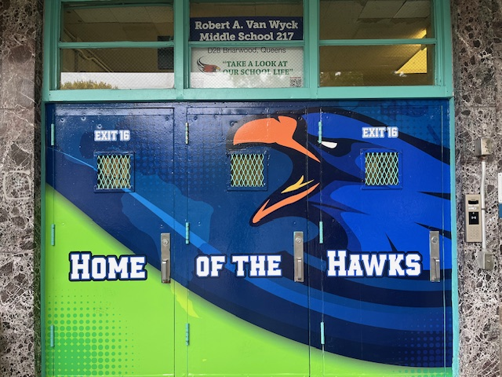
M.S. 217
Olessia.bauer.cec28@gmail.com
Front door upgrade new artwork

Slide 7

M.S. 287 SLT updates
Olessia.bauer.cec28@gmail.com
No construction updates
Elections in May
Water is provided for the student during the state test
May 1st – ice cream party to celebrate state test
Safety and mental support for student in classroom. Teachers and administrators are available to hear the students and to support them.
Parent engagement is increasing.

Slide 8

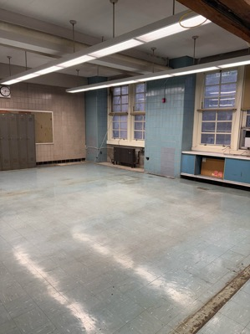
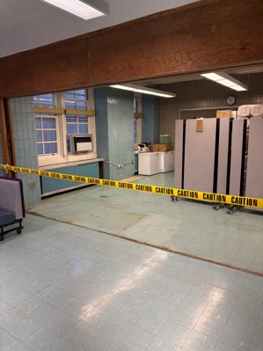
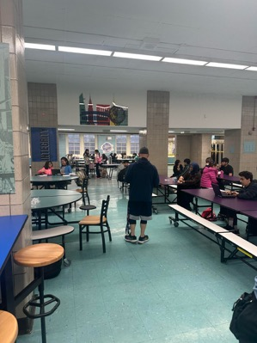
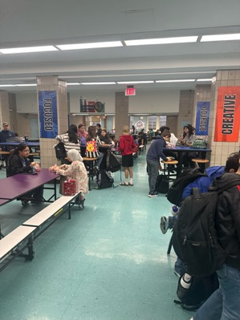
J.H.S 157 April SLT meeting
Cafeteria upgrade starts April 30th – lunch plan – testing date May 1st – upgrade complete May 4th
Olessia.bauer.cec28@gamil.com

